Slide 1
.NET/C# Training
Parthiban
14/11/2023
Notes:
This template can be used as a starter file for presenting training materials in a group setting.
Sections
Right-click on a slide to add sections. Sections can help to organize your slides or facilitate collaboration between multiple authors.
Notes
Use the Notes section for delivery notes or to provide additional details for the audience. View these notes in Presentation View during your presentation.
Keep in mind the font size (important for accessibility, visibility, videotaping, and online production)
Coordinated colors
Pay particular attention to the graphs, charts, and text boxes.
Consider that attendees will print in black and white or grayscale. Run a test print to make sure your colors work when printed in pure black and white and grayscale.
Graphics, tables, and graphs
Keep it simple: If possible, use consistent, non-distracting styles and colors.
Label all graphs and tables.

Slide 2
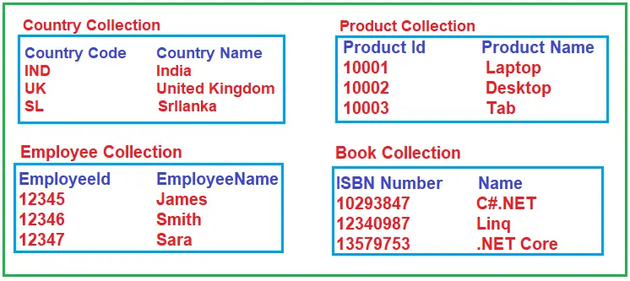
C# Collections
Collections are nothing but groups of records that can be treated as one logical unit.
Notes:
Give a brief overview of the presentation. Describe the major focus of the presentation and why it is important.
Introduce each of the major topics.
To provide a road map for the audience, you can repeat this Overview slide throughout the presentation, highlighting the particular topic you will discuss next.

Slide 3
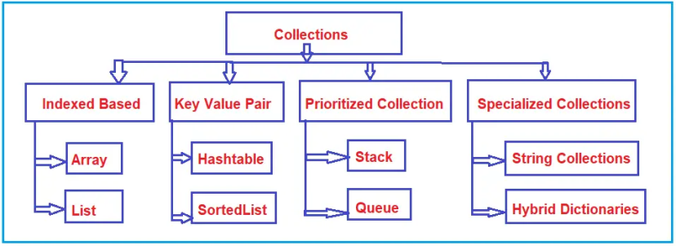
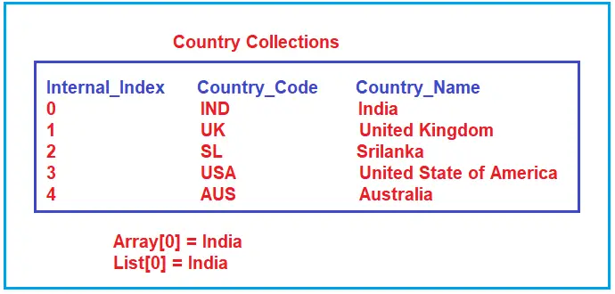

Slide 4
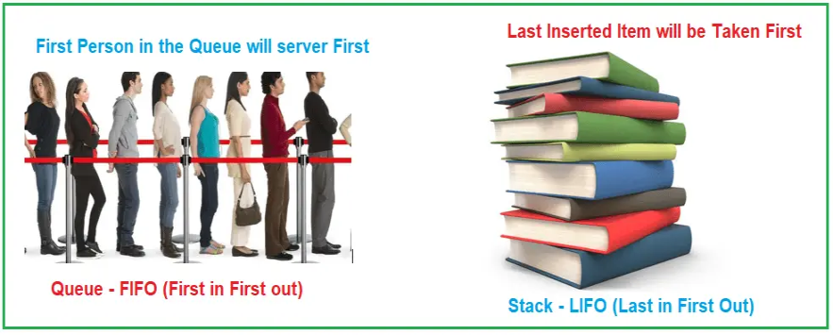

Slide 5
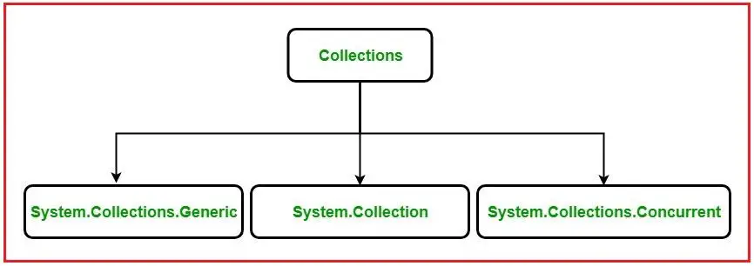
System.Collections classes
System.Collections.Generic classes
System.Collections.Concurrent classes

Slide 6
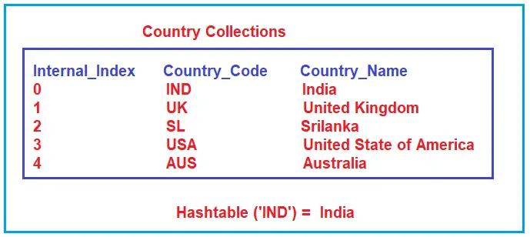

Slide 7
Non-Generic Collections Classes in C#:
ArrayList:
It Implements the System.Collections.IList interface using an array whose size is
dynamically increased as required.
Stack: It represents a simple last-in-first-out (LIFO) non-generic collection of objects.
Queue: It represents a first-in, first-out collection of objects.
Hashtable: It represents a collection of key/value pairs that are organized based on
the hash code of the key.
SortedList: It represents a collection of key/value pairs that are sorted by the keys
and are accessible by key and by index.

Slide 8
ArrayList in C#
ArrayList arrayList1 = new ArrayList();
arrayList1.Add(101); //Adding Integer Value
arrayList1.Add("James"); //Adding String Value
arrayList1.Add("James"); //Adding Duplicate Value
arrayList1.Add(" "); //Adding Empty
arrayList1.Add(true); //Adding Boolean
arrayList1.Add(4.5); //Adding double
arrayList1.Add(null); //Adding null
foreach (var item in arrayList1)
{
Console.WriteLine(item);
}

Slide 9
//Adding Elements to ArrayList using object initializer syntax
var arrayList2 = new ArrayList()
{
102, "Smith", "Smith", true, 15.6
};
foreach (var item in arrayList2)
{
Console.WriteLine(item);
}

Slide 10
//Adding elements to ArrayList using Add() method
ArrayList arrayList1 = new ArrayList();
arrayList1.Add(101); //Adding Integer Value
arrayList1.Add("James"); //Adding String Value
arrayList1.Add(true); //Adding Boolean
arrayList1.Add(4.5); //Adding double
//Accessing individual elements from ArrayList using Indexer
int firstElement = (int)arrayList1[0]; //returns 101
string secondElement = (string)arrayList1[1]; //returns "James"
//int secondElement = (int) arrayList1[1]; //Error: cannot cover string to int
Console.WriteLine($"First Element: {firstElement}, Second Element: {secondElement}");

Slide 11
//Using var keyword without explicit casting
var firsItem = arrayList1[0]; //returns 101
var secondItem = arrayList1[1]; //returns "James"
//var fifthElement = arrayList1[5]; //Error: Index out of range
Console.WriteLine($"First Item: {firsItem}, Second Item: {secondItem}");
//update elements
arrayList1[0] = "Smith";
arrayList1[1] = 1010;
//arrayList1[5] = 500; //Error: Index out of range
foreach (var item in arrayList1)
{
Console.Write($"{item} ");
}

Slide 12
ArrayList arrayList1 = new ArrayList();
arrayList1.Add(101); //Adding Integer Value
arrayList1.Add("James"); //Adding String Value
arrayList1.Add(true); //Adding Boolean
arrayList1.Add(4.5); //Adding double
//Iterating through foreach loop
Console.WriteLine("Using ForEach Loop");
foreach (var item in arrayList1)
{
Console.Write($"{item} ");
}
//Iterating through for loop
Console.WriteLine("\n\nUsing For Loop");
for (int i = 0; i < arrayList1.Count; i++)
{
Console.Write($"{arrayList1[i]} ");
}

Slide 13
ArrayList arrayList = new ArrayList()
{
101,
"James",
true,
10.20
};
//Insert "First Element" at First Position i.e. Index 0
arrayList.Insert(0, "First Element");
//Insert "Third Element" at Third Position i.e. Index 2
arrayList.Insert(2, "Third Element");
//Iterating through foreach loop
foreach (var item in arrayList)
{
Console.WriteLine($"{item}");
}

Slide 14
ArrayList arrayList1 = new ArrayList()
{
"India",
"USA",
"UK",
"Nepal"
};
Console.WriteLine("Array List Elements");
foreach (var item in arrayList1)
{
Console.Write($"{item} ");
}
ArrayList arrayList2 = new ArrayList()
{
"Srilanka",
"Japan",
"Britem"
};
arrayList1.InsertRange(2, arrayList2);
Console.WriteLine("\n\nArray List Elements After InsertRange");
foreach (var item in arrayList1)
{
Console.Write($"{item} ");
}

Slide 15
ArrayList arrayList = new ArrayList()
{
"India",
"USA",
"UK",
"Nepal",
"HongKong",
"Srilanka",
"Japan",
"Britem",
"HongKong",
};
Console.WriteLine("Array List Elements");
foreach (var item in arrayList)
{
Console.Write($"{item} ");
}
arrayList.Remove("HongKong"); //Removes first occurance of null

Slide 16
Console.WriteLine("\n\nArray List Elements After Removing First Occurances of HongKong");
foreach (var item in arrayList)
{
Console.Write($"{item} ");
}
arrayList.RemoveAt(3); //Removes element at index postion 3, it is 0 based index
Console.WriteLine("\n\nArray List1 Elements After Removing Element from Index 3");
foreach (var item in arrayList)
{
Console.Write($"{item} ");
}
arrayList.RemoveRange(0, 2);//Removes two elements starting from 1st item (0 index)
Console.WriteLine("\n\nArray List Elements After Removing First Two Elements");
foreach (var item in arrayList)
{
Console.Write($"{item} ");
}

Slide 17
ArrayList arrayList = new ArrayList()
{
"India",
"USA",
"UK",
"Denmark",
"Nepal",
};
int totalItems = arrayList.Count;
Console.WriteLine(string.Format($"Total Items: {totalItems}, Capacity: {arrayList.Capacity}"));
//Remove all items from the Array list
arrayList.Clear();
totalItems = arrayList.Count;
Console.WriteLine(string.Format($"Total Items After Clear(): {totalItems}, Capacity: {arrayList.Capacity}"));
Console.ReadKey();
}

Slide 18
ArrayList arrayList = new ArrayList()
{
"India",
"UK",
"Nepal",
101
};
Console.WriteLine("Array List Elements");
foreach (var item in arrayList)
{
Console.Write($"{item} ");
}
Console.WriteLine($"\n\nIs ArrayList Contains India: {arrayList.Contains("India")}"); // true
Console.WriteLine($"Is ArrayList Contains USA: {arrayList.Contains("USA")}"); // false
Console.WriteLine($"Is ArrayList Contains 101: {arrayList.Contains(101)}"); // true
Console.WriteLine($"Is ArrayList Contains 10.5: {arrayList.Contains(10.5)}"); // false
Console.ReadKey();
}

Slide 19
ArrayList arrayList = new ArrayList()
{
"India",
"USA",
"UK",
"Denmark",
"HongKong",
};
Console.WriteLine("Array List Elements:");
foreach (var item in arrayList)
{
Console.WriteLine($"{item} ");
}
//Creating a clone of the arrayList using Clone method
ArrayList cloneArrayList = (ArrayList)arrayList.Clone();
Console.WriteLine("\nCloned ArrayList Elements:");
foreach (var item in cloneArrayList)
{
Console.WriteLine($"{item} ");
}

Slide 20
ArrayList arrayList = new ArrayList()
{
"India",
"USA",
"UK",
"Denmark",
"HongKong",
};
Console.WriteLine("Array List Elements:");
foreach (var item in arrayList)
{
Console.WriteLine($"{item} ");
}
//Copying the arrayList to an object array
object[] arrayListCopy = new object[arrayList.Count];
arrayList.CopyTo(arrayListCopy);
Console.WriteLine("\nArrayList Copy Array Elements:");
foreach (var item in arrayListCopy)
{
Console.WriteLine(item);
}

Slide 21
ArrayList arrayList = new ArrayList()
{
"India",
"USA",
"UK",
"Denmark",
"Nepal",
"HongKong",
"Austrailla",
"Srilanka",
"Japan",
"Britem",
"Brazil",
};
Console.WriteLine("Array List Elements Before Sorting");
foreach (var item in arrayList)
{
Console.Write($"{item} ");
}
// Sorting the elements of ArrayList Using sort() method
arrayList.Sort();
Console.WriteLine("\n\nArray List Elements After Sorting");
foreach (var item in arrayList)
{
Console.Write($"{item} ");
}

Slide 22
Array:
Fixed Length
Cannot insert it into the middle
Cannot delete from middle
It is type-safe, so we can store only similar types of data based on the data type.
Boxing and Unboxing are not required.
ArrayList:
Variable Length
Can insert an element into the middle of the collection
Can delete elements from the middle of the collection
It is not type-safe, so we can store any type of data.
Boxing and Unboxing are required as it is operated on the object data type.

Slide 23
Property | Description
Capacity | It is useful to get or set the number of elements an arraylist can contain.
Count | It is useful to get the number of elements in an arraylist.
IsFixedSize | It is useful to get a value to indicate whether the arraylist has a fixed size or not.
IsReadOnly | It is useful to get a value to indicate whether the arraylist is read-only or not.
Item | It is used to get or set an element at the specified index.
IsSynchronized | It is used to get a value to indicate whether access to arraylist is synchronized (thread-safe) or not.

Slide 24
Method | Description
Add | It is useful to add an element at the end of the arraylist.
AddRange | It is useful to add all the elements of the specified collection at the end of the arraylist.
Clear | It will remove all the elements in the arraylist.
Clone | It will create a shallow copy of the arraylist.
Contains | It is useful to determine whether the specified element exists in an arraylist or not.
CopyTo | It is useful to copy all the elements of an arraylist into another compatible array.
GetRange | It is useful to return a specified range of arraylist elements starting from the specified index.
Notes:
Give a brief overview of the presentation. Describe the major focus of the presentation and why it is important.
Introduce each of the major topics.
To provide a road map for the audience, you can repeat this Overview slide throughout the presentation, highlighting the particular topic you will discuss next.

